Slide 1

Script Walkthrough

Slide 2
What each script does
DIFF (Two files)
Can compare two Excel files
Highlights differences: Green = new, Red = changed, Grey = removed
Format Check (One file)
Setup: (only needs to be run once) Uses a sample file as a reference for formatting - Creates json file
Running: Analyzes given file with json as reference for formatting
Number Check (One file)
Setup: Uses 3x Standard Deviation from numeric column as default values (Covers ~99.7%)
Running: Compares values in numeric column with range created by setup

Slide 3
Be sure to have Python or Anaconda

Slide 4
Links to Python Distributions (Pick one)
Anaconda:
https://www.anaconda.com/distribution/
Miniconda:
https://docs.conda.io/en/latest/miniconda.html
Vanilla Python:
https://www.python.org/downloads/release/python-374/

Slide 5
Command Line stuff - Changing Directory (Folder)
Type cd followed by a path (Case insensitive) to change directories
Note: If the path contains white space, put it in quotes
E.g. cd documents/github/revdoi-data-quality/scripts

Slide 6
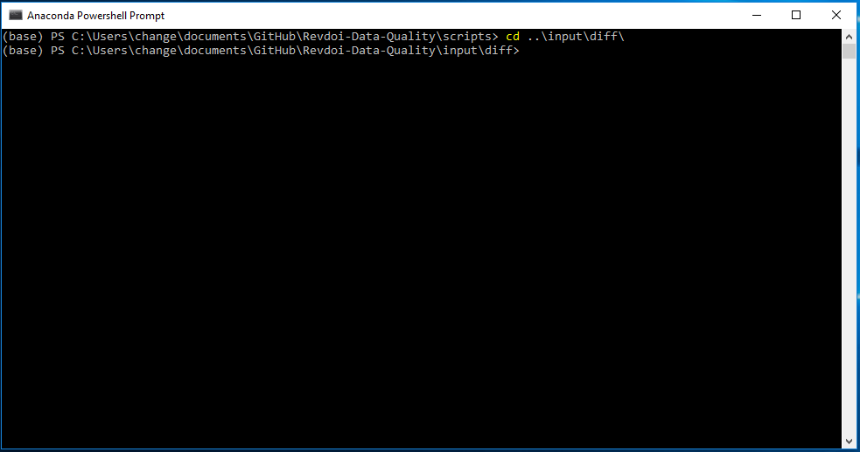
Command Line stuff - Changing Directory (Folder)
To navigate backwards, type cd ..
Can be followed by any path within that directory

Slide 7
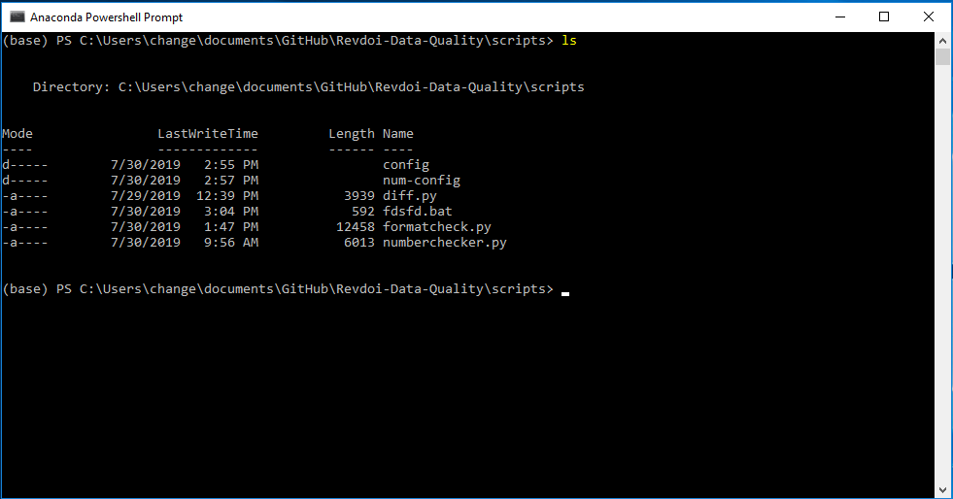
Command Line stuff - dir / ls
dir or ls will print out anything listed under the current directory

Slide 8
Command Line stuff - Running Python scripts
Type python followed by the name of the script
E.g python hello.py

Slide 9
Sample Locations
Diff samples
../input/diff
Format Sample
../input/setup
../input/formatTest
Number Sample
../input/numTest

Slide 10
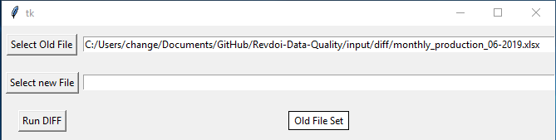
Running the Scripts - diff.py
Cd [someplace]/revdoi-data-quality-master/scripts
python diff.py
Use the buttons to select files, then click “run diff” to compare the files

Slide 11
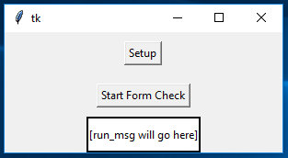
Running the Scripts - formatcheck.py
Python formatcheck.py
Run setup if a JSON file has not already been not created for a specific data type
Found under Revdoi-Data-Quality/scripts/config
Start Form Check
Prints and Exports Anomalies

Slide 12
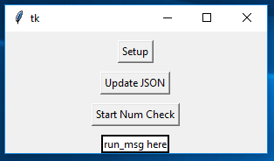
Running the Scripts - numberchecker.py
Can work without calling setup
Python numberchecker.py
Setup
Only need to be run once per data type
Asks for input on which columns to use for grouping
Creates a .json file with thresholds based on SD, is editable.
Start Num Check
Prints out values surpassing certain thresholds
Will export to output/NumChecked-filename.xlsx

Slide 13
In case I forgot something
Link to Data Script Wiki:
https://github.com/ONRR/Revdoi-Data-Quality/wiki
Glossary:
https://github.com/ONRR/Revdoi-Data-Quality/wiki/Glossary

